Slide 1
CPE 221: Computer Organization
14 Single Cycle ARM Processor
rahul.bhadani@uah.edu

Slide 2
Microarchitecture
Multiple implementations for a single architecture:​
Single-cycle: Each instruction executes in a single cycle​
Multicycle: Each instruction is broken up into series of shorter steps​
Pipelined: Each instruction broken up into series of steps & multiple instructions execute at once​

Slide 3
Processor Performance​
Program execution time​
​
Execution Time = (#instructions)(cycles/instruction)(seconds/cycle)​
​
Definitions:​
CPI: Cycles/instruction​
clock period: seconds/cycle​
IPC: instructions/cycle = IPC​
Challenge is to satisfy constraints of:​
Cost​
Power​
Performance​
​

Slide 4
ARM Processor​
Consider subset of ARM instructions:​
Data-processing instructions: ​
ADD, SUB, AND, ORR​
with register and immediate Src2, but no shifts ​
Memory instructions: ​
LDR, STR​
with positive immediate offset​
Branch instructions: ​
B​
​

Slide 5
Architectural State Elements​
Determines everything about a processor:​
Architectural state:​
16 registers (including PC)​
Status register​
Memory​

Slide 6
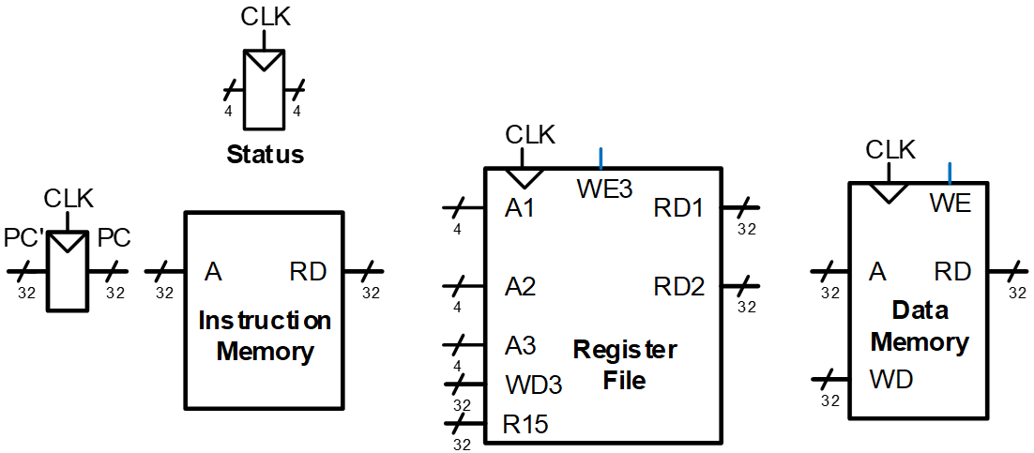
ARM Architectural State Elements​

Slide 7
Single-Cycle ARM Processor​
Datapath​
Control​

Slide 8
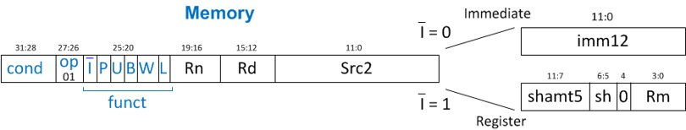
Single-Cycle ARM Processor​
Datapath: start with LDR instruction​
Example:
LDR R1, [R2, #5]​
LDR Rd, [Rn, imm12]​

Slide 9
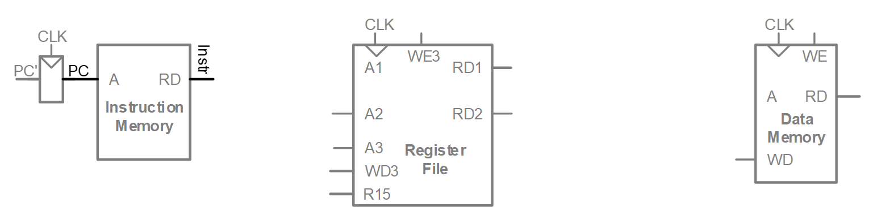
Single-Cycle Datapath: LDR fetch​
STEP 1: Fetch instruction​

Slide 10
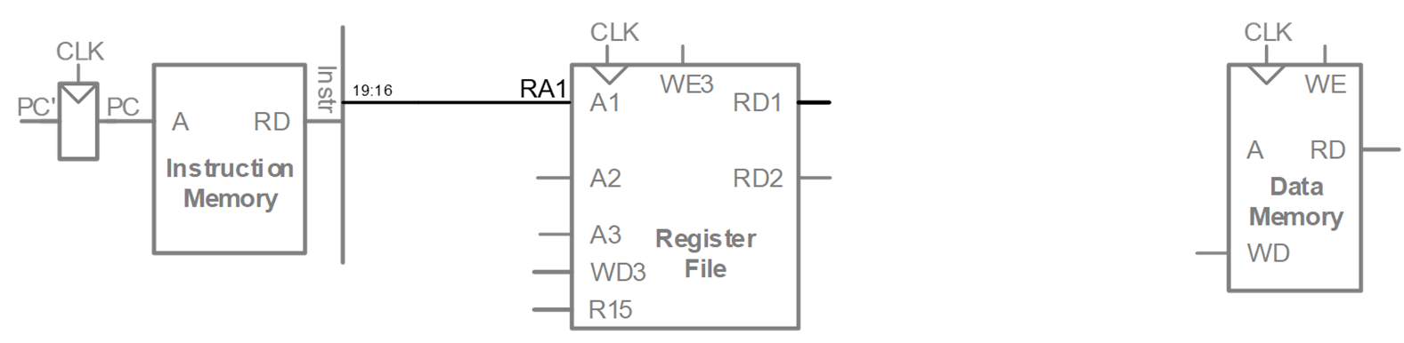

Single-Cycle Datapath: LDR Reg Read​
STEP 2: Read source operands from RF​
LDR Rd, [Rn, imm12]​

Slide 11
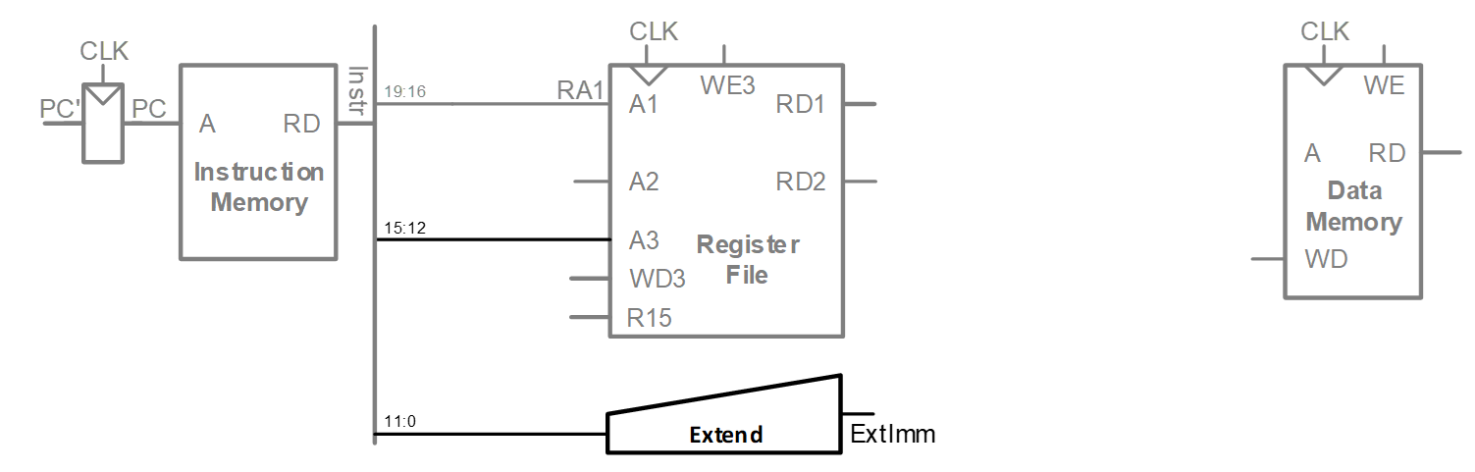
Single-Cycle Datapath: LDR Immed.​
STEP 3: Extend the immediate​
LDR Rd, [Rn, imm12]​

Slide 12
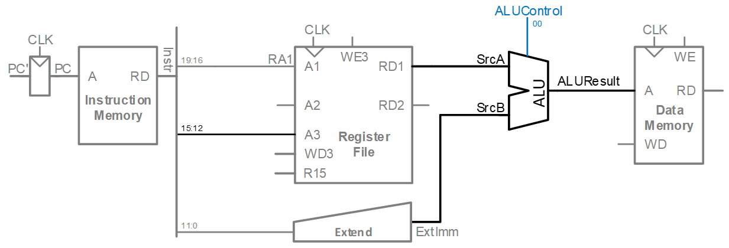

Single-Cycle Datapath: LDR Address​
STEP 4: Compute the memory address​
LDR Rd, [Rn, imm12]​

Slide 13
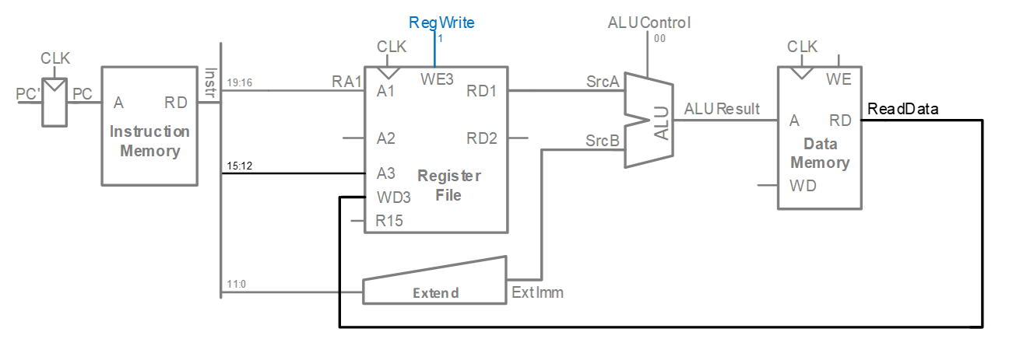
Single-Cycle Datapath: LDR Mem Read​
STEP 5: Read data from memory and write it back to register file​
LDR Rd, [Rn, imm12]​

Slide 14
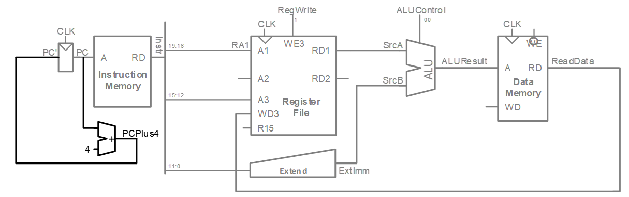
Single-Cycle Datapath: PC Increment​
STEP 6: Determine address of next instruction​
Calculate the address of the next instruction

Slide 15
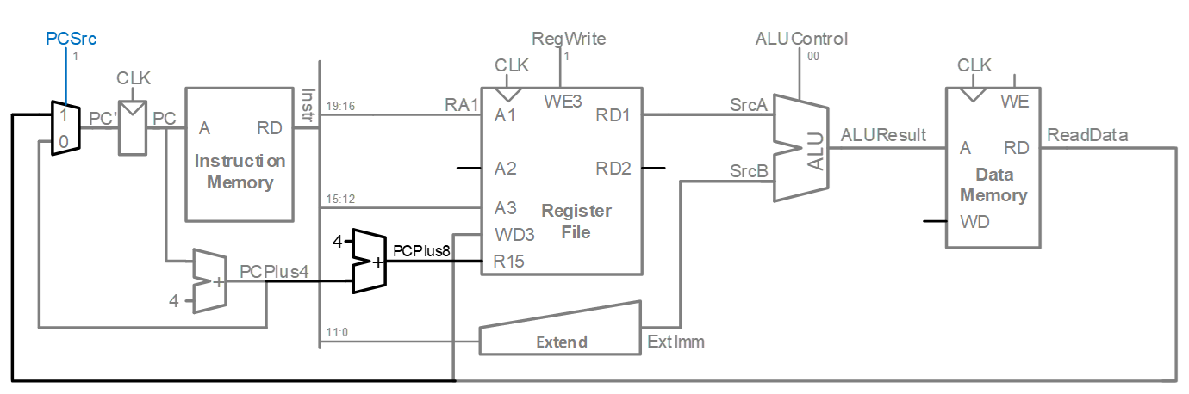
Single-Cycle Datapath: Access to PC​ <Case of Destination being R15/PC>
PC (R15) can be source/destination of instruction​

Slide 16
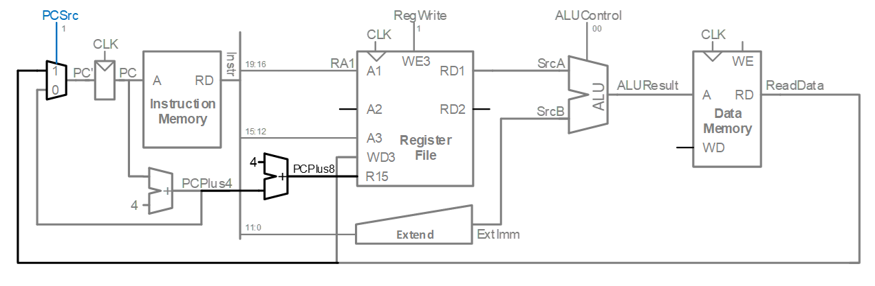
Single-Cycle Datapath: Access to PC​ <Case of Destination being R15/PC>
PC can be source/destination of instruction​
Source: R15 must be available in Register File​
PC is read as the current PC plus 8​
​

Slide 17
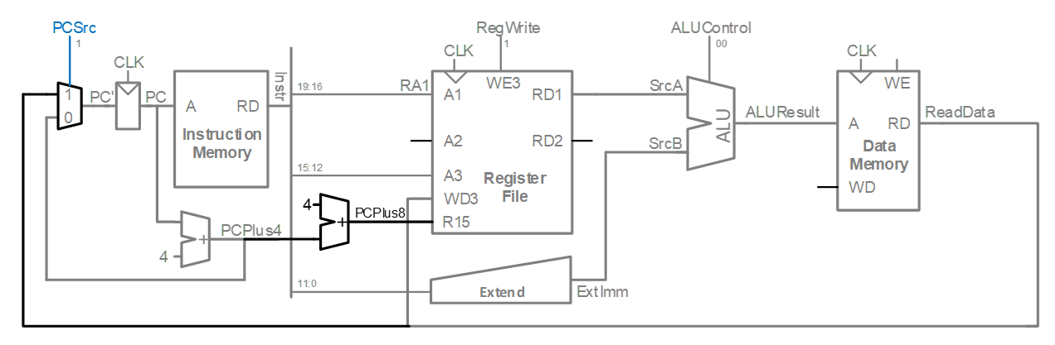
Single-Cycle Datapath: Access to PC​ <Case of Destination being R15/PC>
PC can be source/destination of instruction​
Source: R15 must be available in Register File​
PC is read as the current PC plus 8​
Destination: Be able to write result to PC​

Slide 18
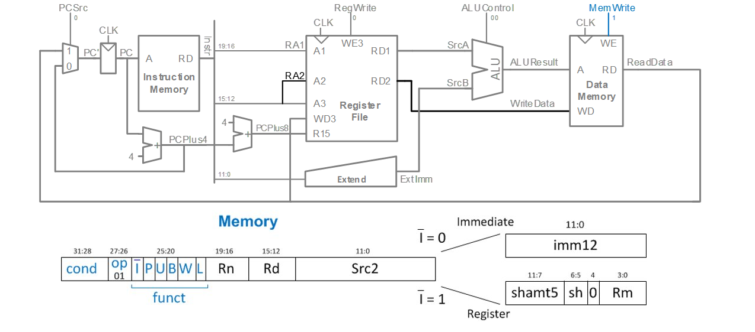
Single-Cycle Datapath: STR​
Expand datapath to handle STR:​
Write data in Rd to memory​
STR Rd, [Rn, imm12]​

Slide 19
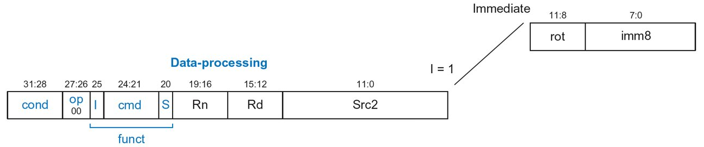
Single-Cycle Datapath: Data-processing​
With immediate Src2:​
Read from Rn and Imm8 (ImmSrc chooses the zero-extended Imm8 instead of Imm12)​
Write ALUResult to register file​
Write to Rd​
ADD Rd, Rn, imm8​

Slide 20
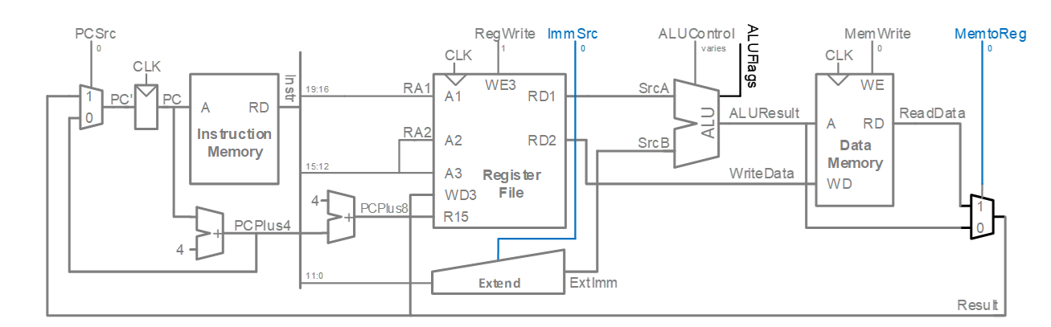
Single-Cycle Datapath: Data-processing​
With immediate Src2:​
Read from Rn and Imm8 (ImmSrc chooses the zero-extended Imm8 instead of Imm12)​
Write ALUResult to register file​
Write to Rd​
ADD Rd, Rn, imm8​

Slide 21
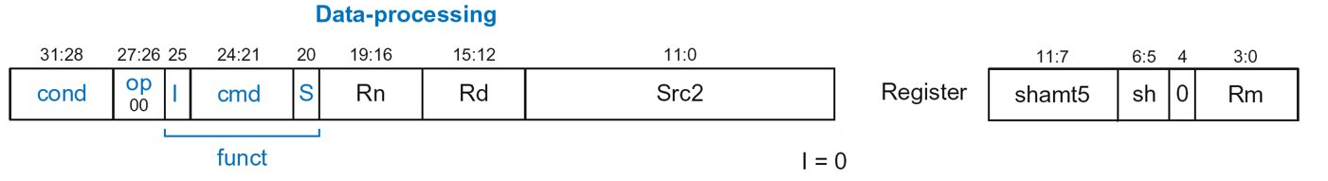
Single-Cycle Datapath: Data-processing​
With register Src2:​
Read from Rn and Rm (instead of Imm8)​
Write ALUResult to register file​
Write to Rd​
ADD Rd, Rn, Rm

Slide 22
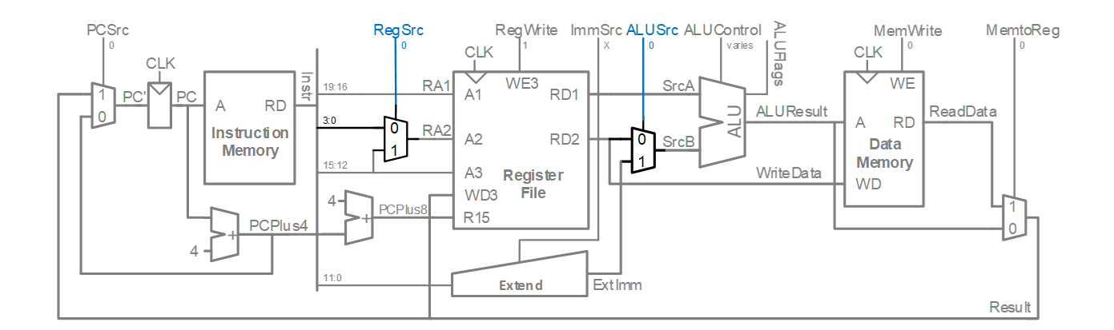
Single-Cycle Datapath: Data-processing​
With register Src2:​
Read from Rn and Rm (instead of Imm8)​
Write ALUResult to register file​
Write to Rd​
Same ALU handles, ADD (00), SUB(01), AND (10), ORR (11)
ADD Rd, Rn, Rm

Slide 23
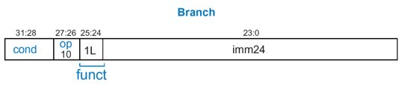
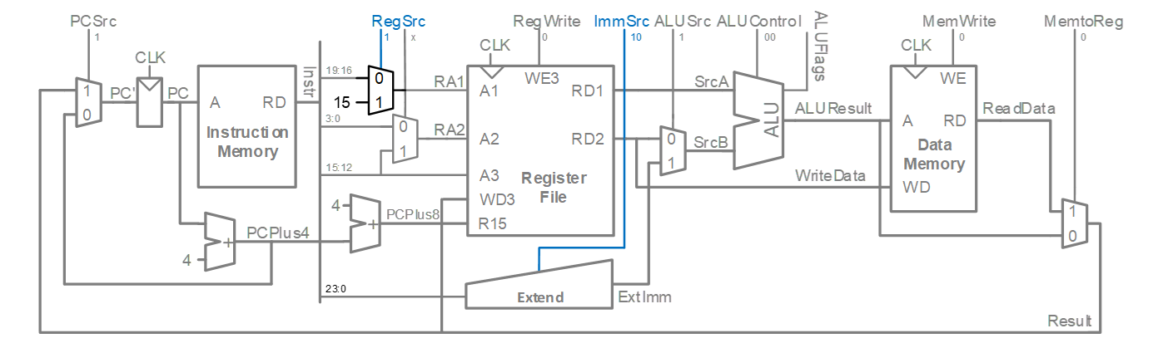
Single-Cycle Datapath: B​
Calculate branch target address:
BTA = (ExtImm) + (PC + 8)​
ExtImm = Imm24 << 2 and sign-extended ​

Slide 24
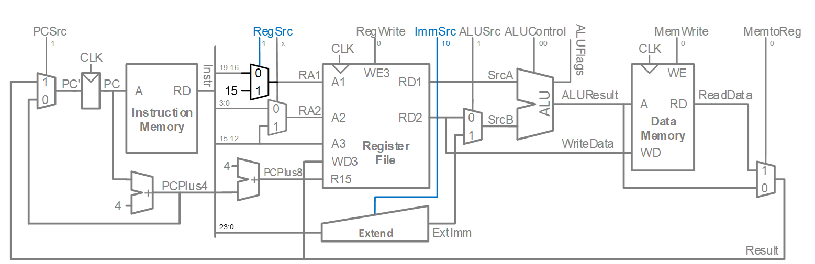
Single-Cycle Datapath: ExtImm​
ImmSrc_{1:0}​ | ExtImm​ | Description​
00​ | {24 0s, Instr_{7:0}}​ | Zero-extended imm8​
01​ | {20 0s, Instr_{11:0}}​ | Zero-extended imm12​
10​ | {6 Instr₂₃}, Instr_{23:0}}​ | Sign-extended imm24​

Slide 25
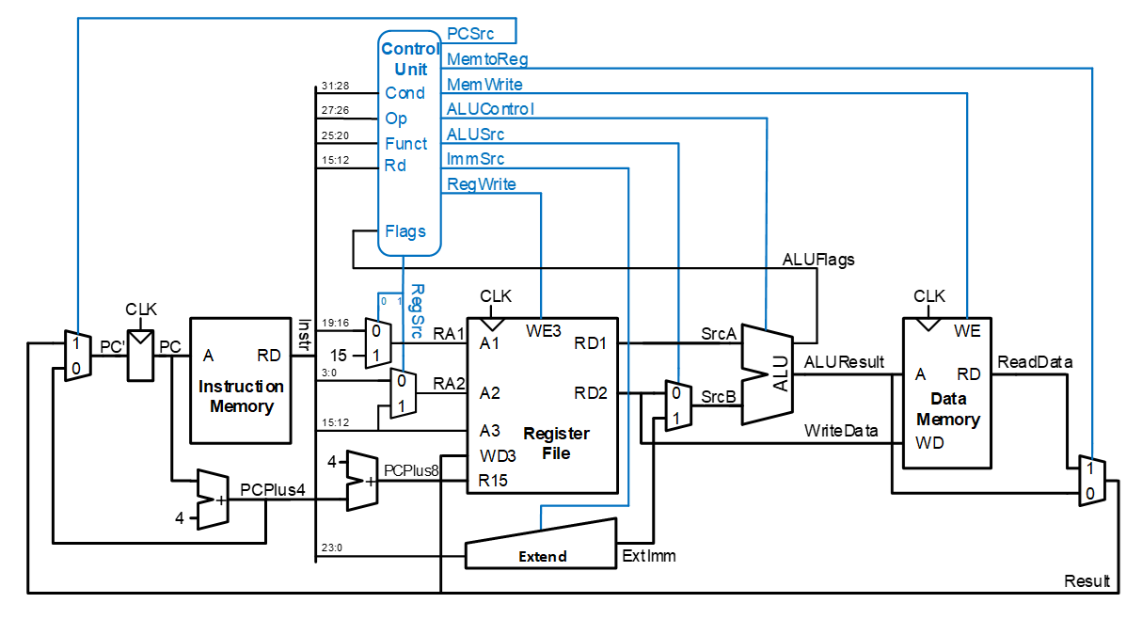
Single-Cycle ARM Processor​

Slide 26
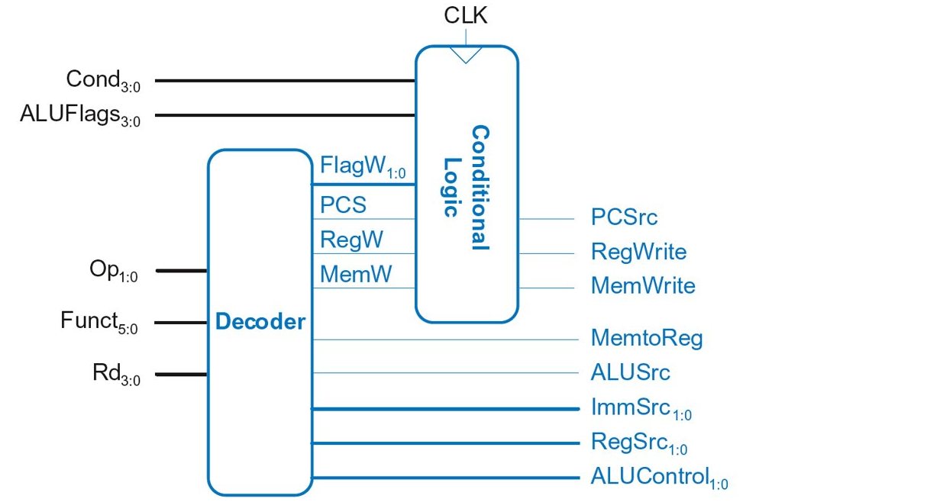
Single-Cycle Control​

Slide 27
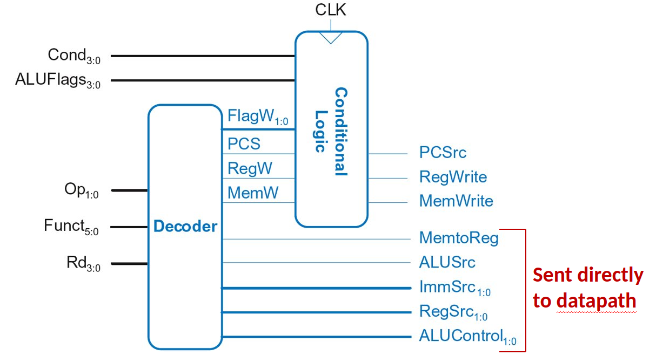
Single-Cycle Control​

Slide 28
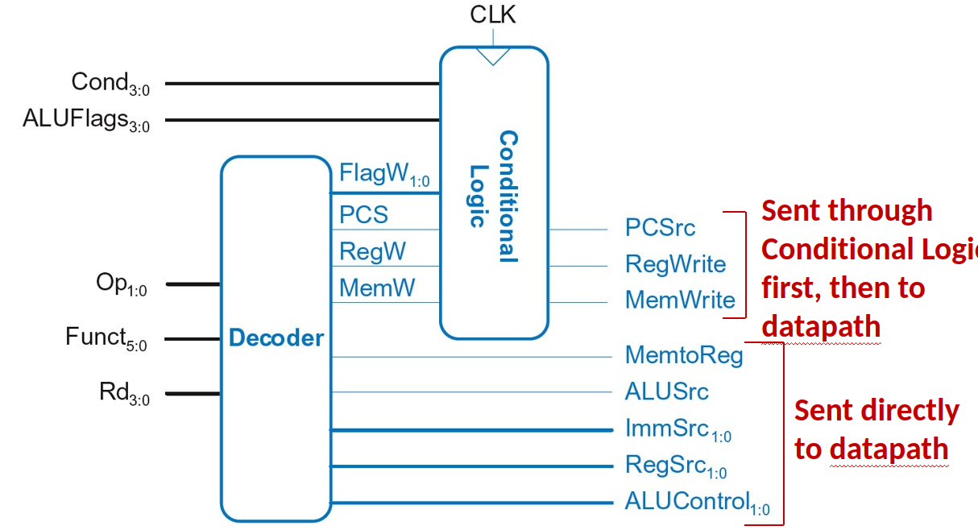
Single-Cycle Control​

Slide 29
Single-Cycle Control​
These signals change the state (PC, RF, Memory)​.
If instruction shouldn’t execute, forced to 0​

Slide 30
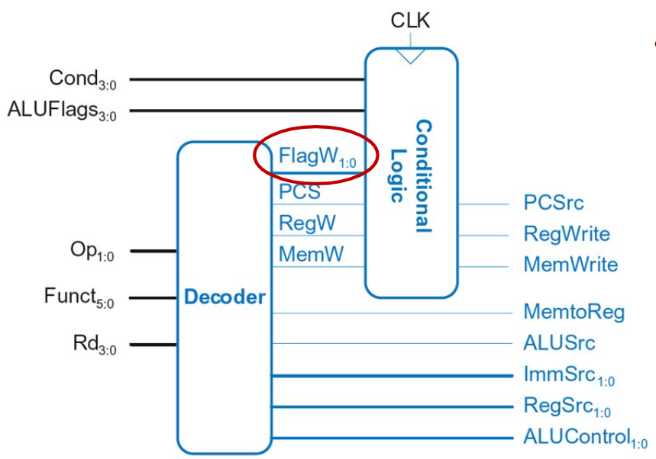
Single-Cycle Control​
FlagW_{1:0}: Flag Write signal, asserted when ALUFlags should be saved (i.e., on instruction with S=1)​
ADD, SUB update all flags (NZCV)​
AND, ORR only update NZ flags​
So, two bits needed:​
FlagW₁ = 1: NZ saved (ALUFlags3:2 saved)​
FlagW₀ = 1: CV saved (ALUFlags1:0 saved)​

Slide 31
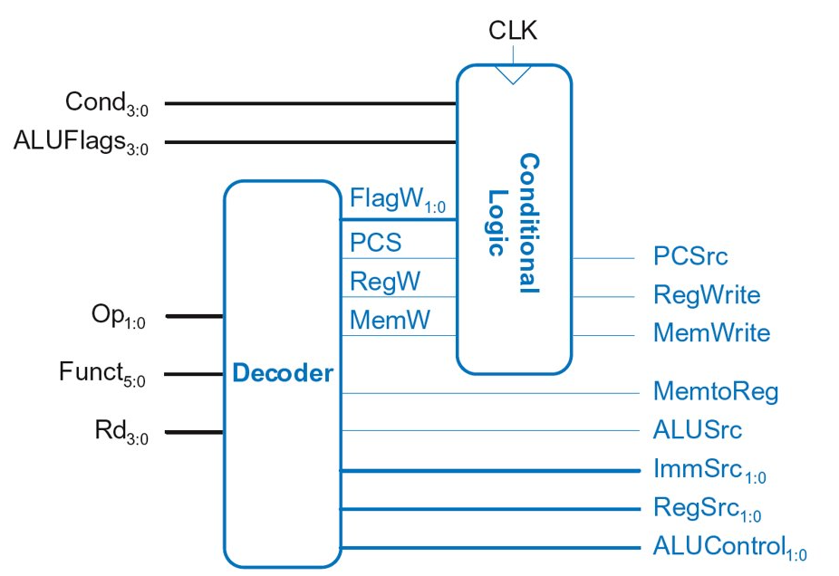
Single-Cycle Control​

Slide 32
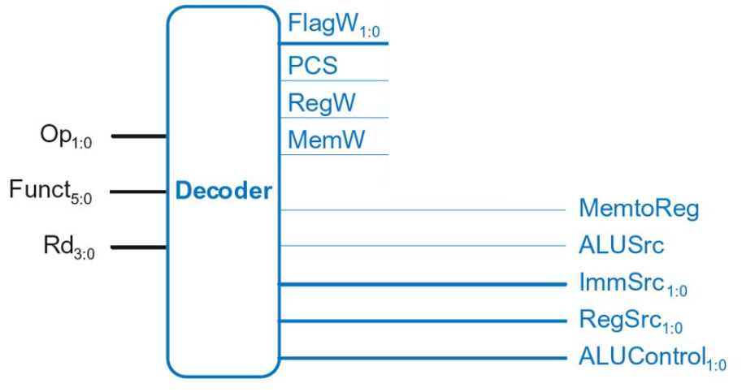
Single-Cycle Control: Decoder​

Slide 33
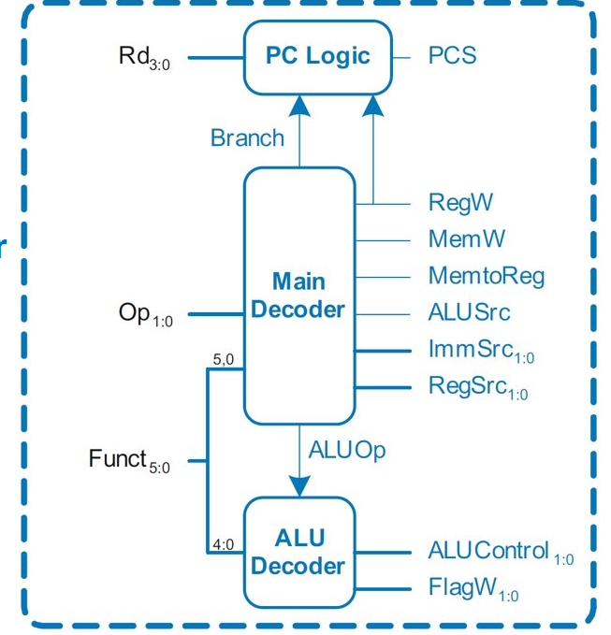
Single-Cycle Control: Decoder​
Submodules:​
Main Decoder​
ALU Decoder​
PC Logic​

Slide 34
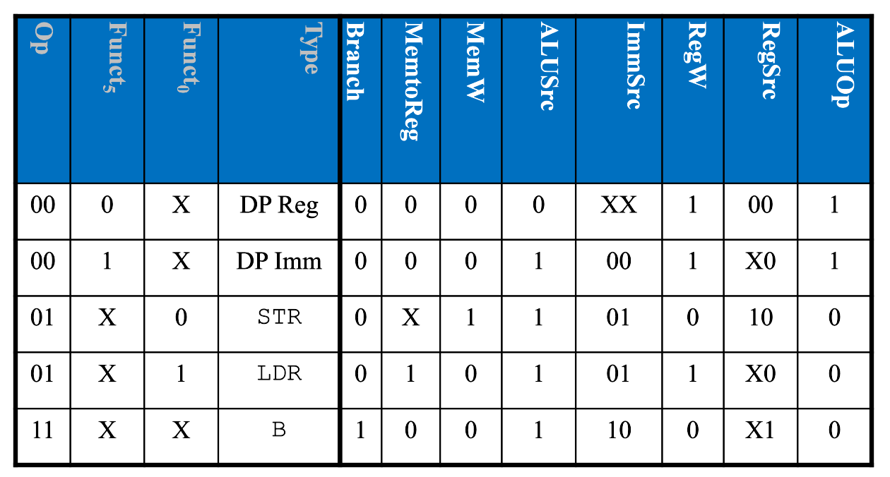
Control Unit: Main Decoder​

Slide 35
Single-Cycle Control: Decoder​
Submodules:​
Main Decoder​
ALU Decoder​
PC Logic​

Slide 36
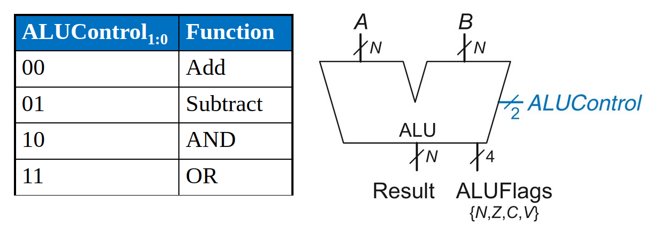
Review: ALU​

Slide 37
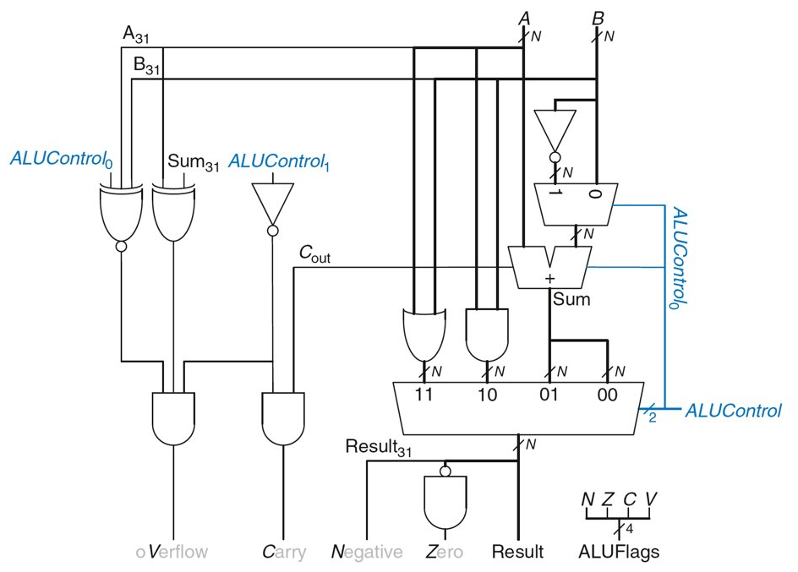
ALU

Slide 38
Single-Cycle Control: Decoder​
Submodules:​
Main Decoder​
ALU Decoder​
PC Logic​

Slide 39
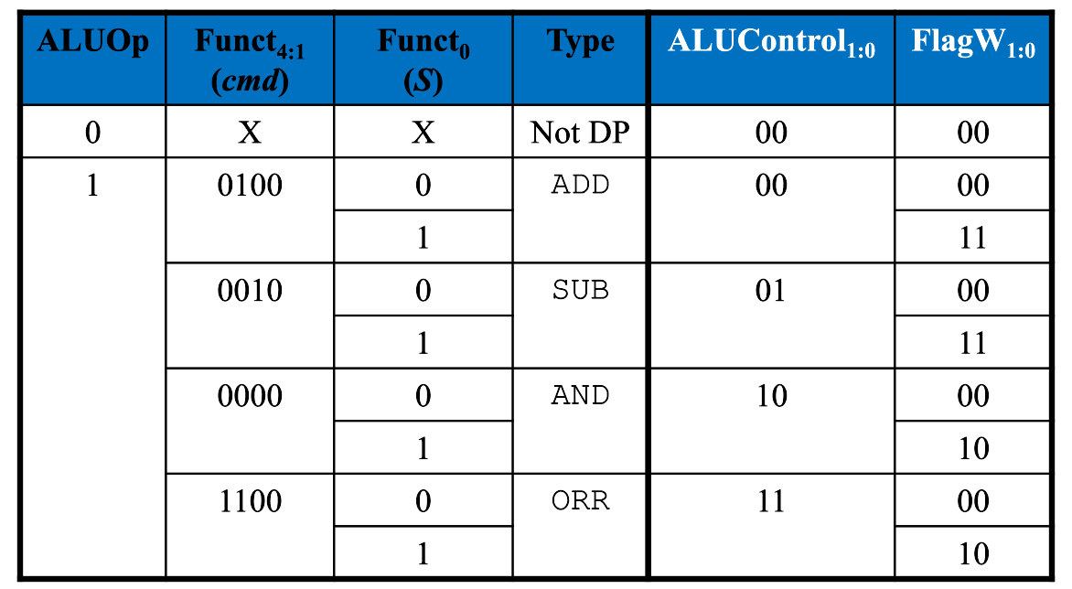
Control Unit: ALU Decoder​
FlagW1 = 1: NZ (Flags3:2) should be saved​
FlagW0 = 1: CV (Flags1:0) should be saved

Slide 40
Single-Cycle Control: Decoder​
Submodules:​
Main Decoder​
ALU Decoder​
PC Logic​

Slide 41
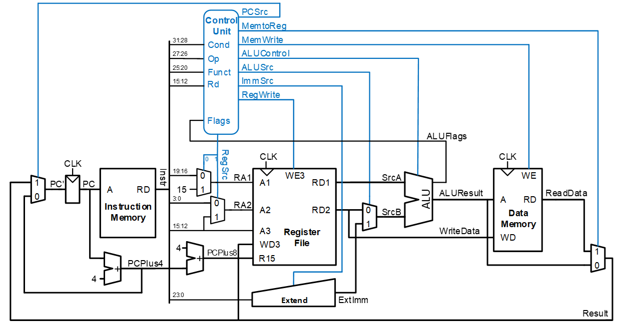
Single-Cycle Control: PC Logic​
PCS = 1 if PC is written by an instruction or branch (B):​
PCS = ((Rd == 15) & RegW) | Branch​
If instruction is executed: PCSrc = PCS​
Else PCSrc = 0 (i.e., PC = PC + 4) ​

Slide 42
Single-Cycle Control: Cond. Logic​

Slide 43
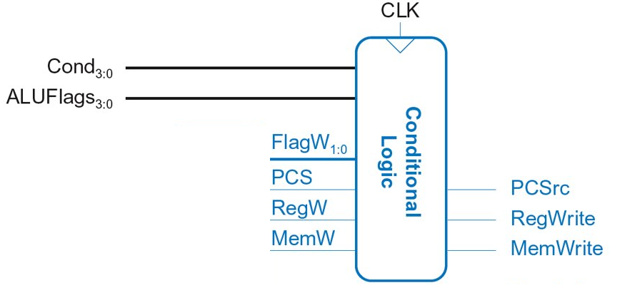
Single-Cycle Control: Cond. Logic​
Function: ​
Check if instruction should execute (if not, force PCSrc, RegWrite, and MemWrite to 0)​
Possibly update Status Register (Flags_{3:0})​
​

Slide 44
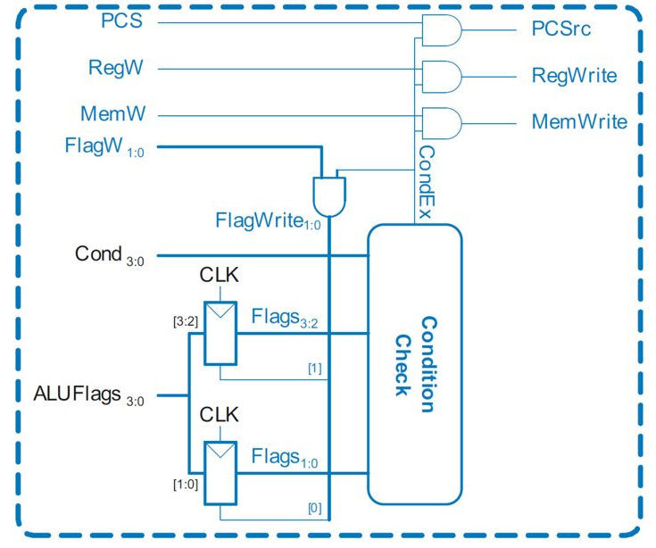
Single-Cycle Control: Cond. Logic​
Function: ​
Check if instruction should execute (if not, force PCSrc, RegWrite, and MemWrite to 0)​​

Slide 45
Single-Cycle Control: Cond. Logic​
Flags3:0 is the status register​
Function: ​
Check if instruction should execute (if not, force PCSrc, RegWrite, and MemWrite to 0)​​
Depending on condition mnemonic (Cond3:0) and condition flags (Flags3:0) the instruction is executed (CondEx = 1)​

Slide 46
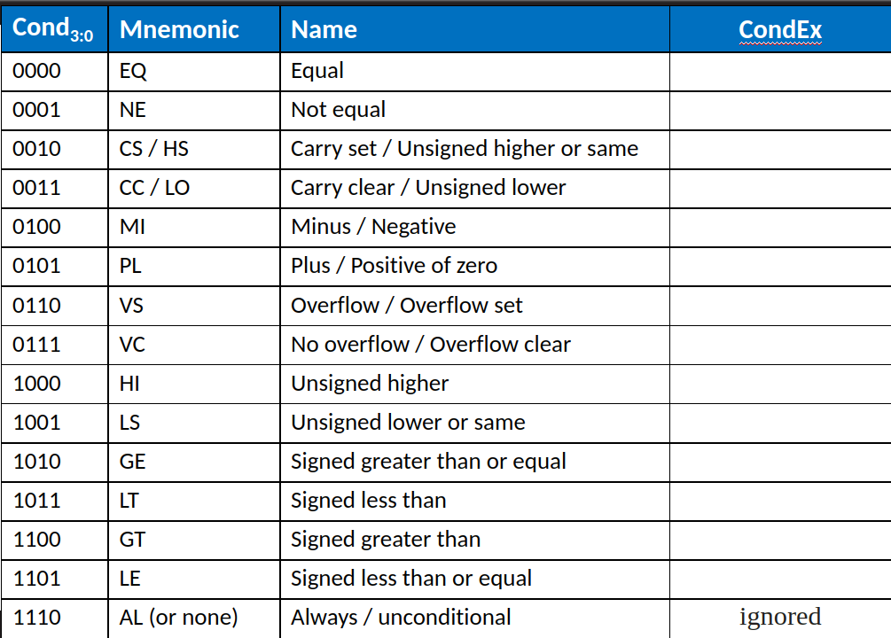
Review: Condition Mnemonics​

Slide 47
Conditional Logic: Conditional Execution​
Flags3:0 is the status register​
Example:
AND R1, R2, R3​
Cond3:0=1110 (unconditional) => CondEx = 1​

Slide 48
Conditional Logic: Conditional Execution​
Flags3:0 is the status register​
Example:
EOREQ R5, R6, R7​
Cond3:0=0000 (EQ): if Flags3:2=0100 => CondEx = 1

Slide 49
Conditional Logic​
Function: ​
Possibly update Status Register (Flags_{3:0})​
​

Slide 50
Single-Cycle Control: Cond. Logic​
Flags3:0 is the status register​
Flags_{3:0} = NZCV​
Flags_{3:0} updated (with ALUFlags_{3:0})
if: ​
FlagW is 1 (i.e., the instruction’s S-bit is 1) AND ​
CondEx is 1 (the instruction should be executed)​

Slide 51
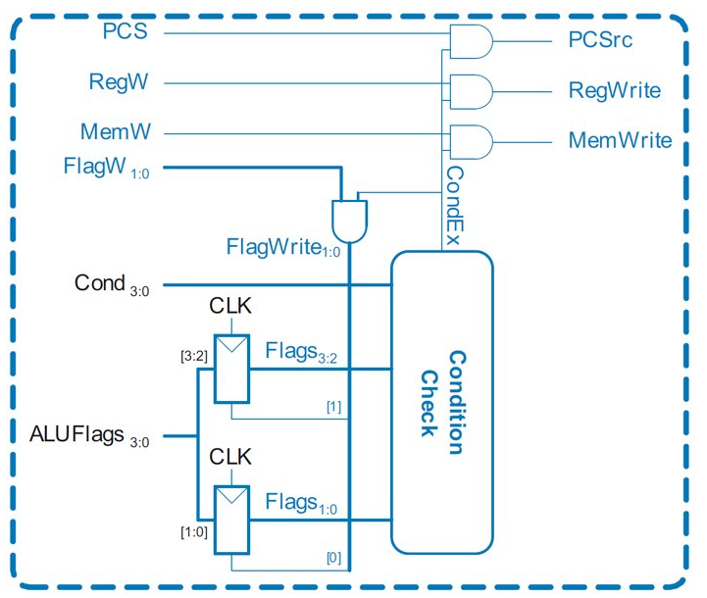
Conditional Logic: Update (Set) Flags​
Recall:​
ADD, SUB update all Flags ​
AND, OR update NZ only ​
So Flags status register has two write enables: FlagW1:0​

Slide 52
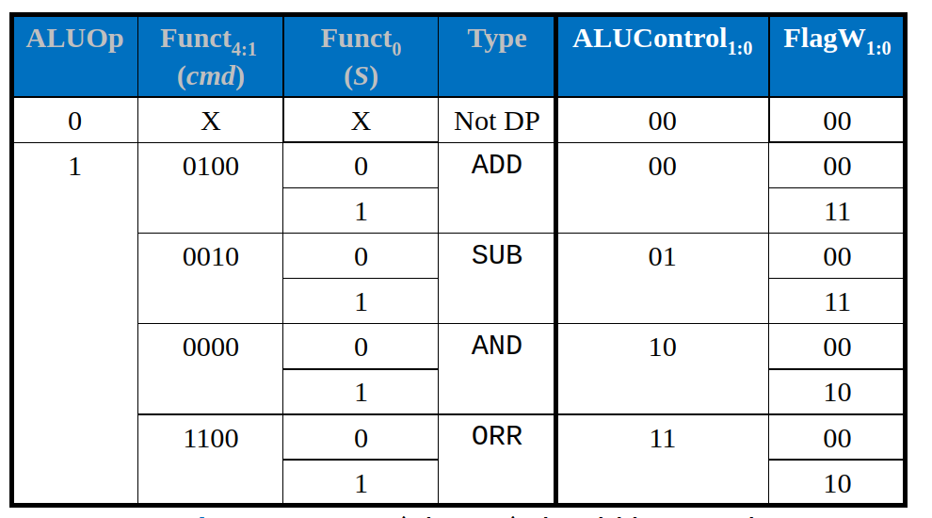
Review: ALU Decoder​
FlagW1 = 1: NZ (Flags3:2) should be saved​
FlagW0 = 1: CV (Flags1:0) should be saved ​

Slide 53
Single-Cycle Control: Cond. Logic​
Flags3:0 is the status register​
Example: SUBS R5, R6, R7​ FlagW_{1:0} = 11 AND CondEx = 1 (unconditional) => FlagWrite_{1:0} = 11 ​
All Flags updated
​

Slide 54
Single-Cycle Control: Cond. Logic​
Flags3:0 is the status register​
Example: ANDS R7, R1, R3​
FlagW1:0 = 10 AND CondEx = 1 (unconditional) => FlagWrite1:0 = 10 ​
Flags3:0 = NZCV​
​
Only Flags3:2 updated​
i.e., only NZ Flags updated​
​

Slide 55
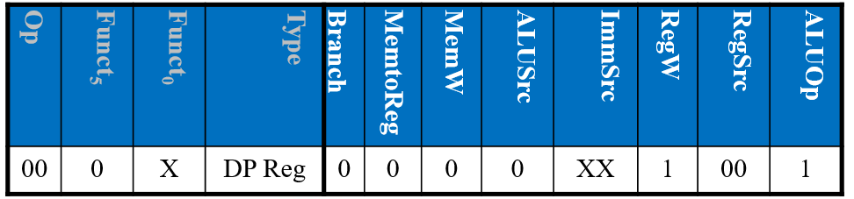
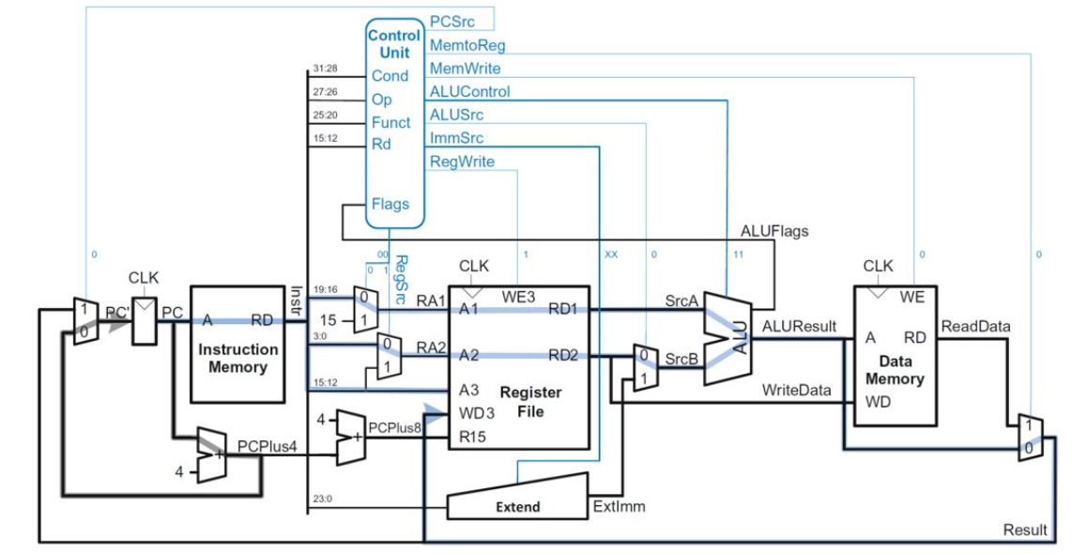
Example: ORR​

Slide 56
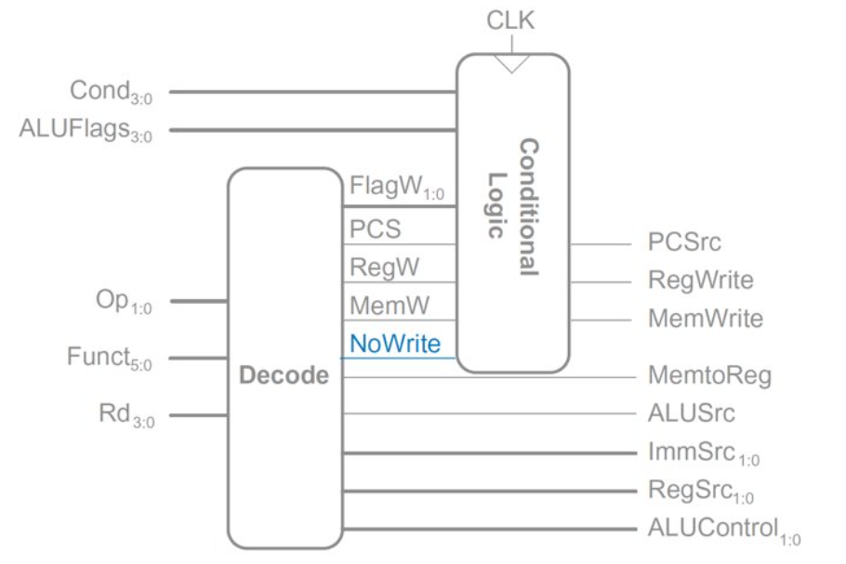
Extended Functionality: CMP​
No change to datapath​

Slide 57
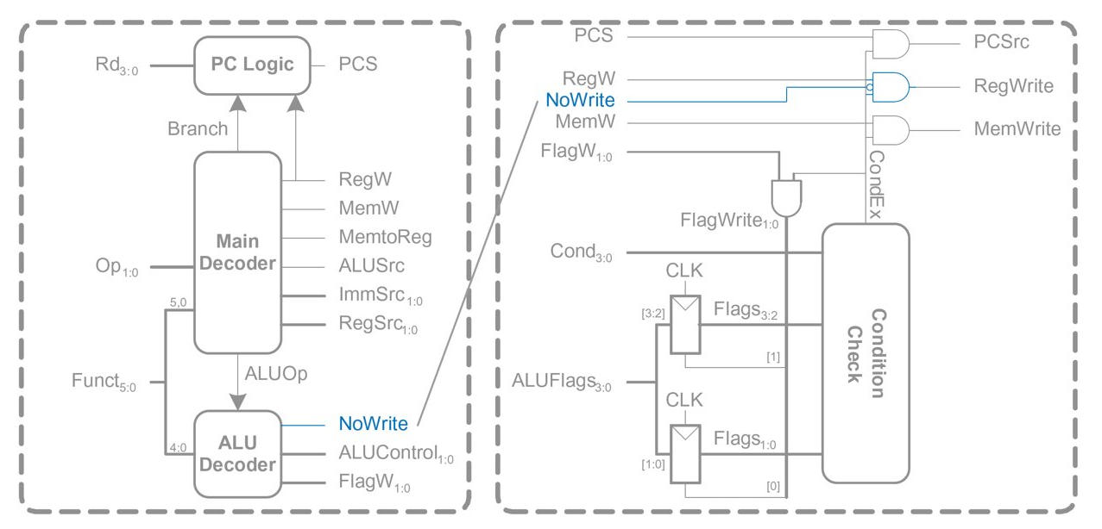
Extended Functionality: CMP​ (look inside)

Slide 58
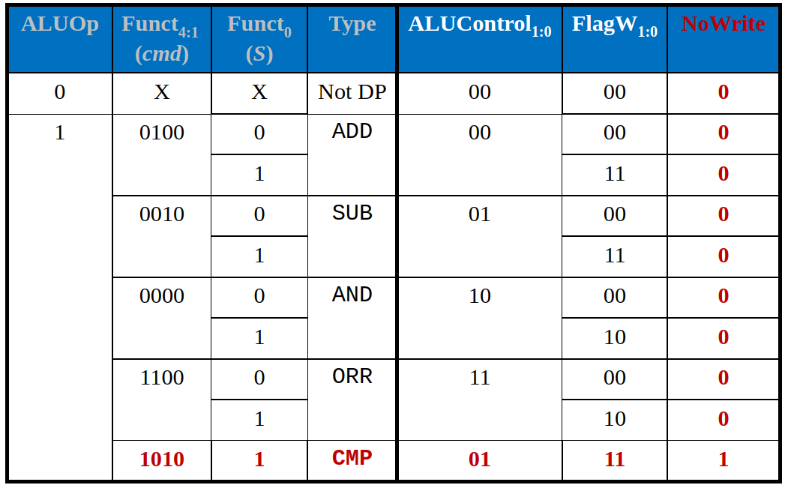
Extended Functionality: CMP

Slide 59
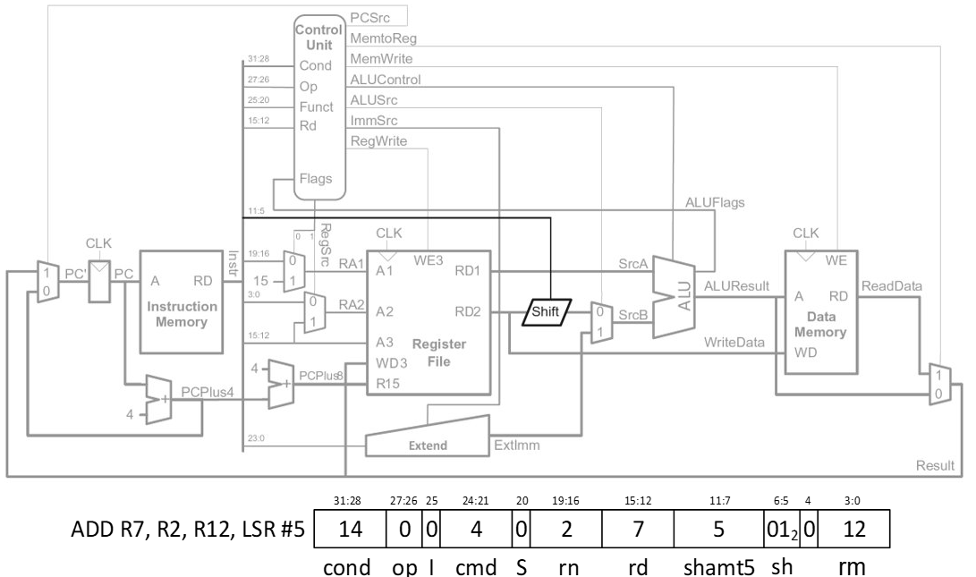
Extended Functionality: Shifted Register​
No change to controller​

Slide 60
Processor Performance

Slide 61
Processor Performance​
Program Execution Time ​
= (#instructions)(cycles/instruction)(seconds/cycle)​
= # instructions x CPI x TC​

Slide 62
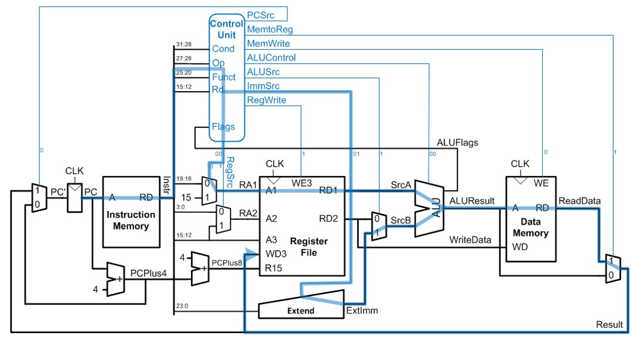
Single-Cycle Performance​
TC limited by critical path (LDR)​

Slide 63
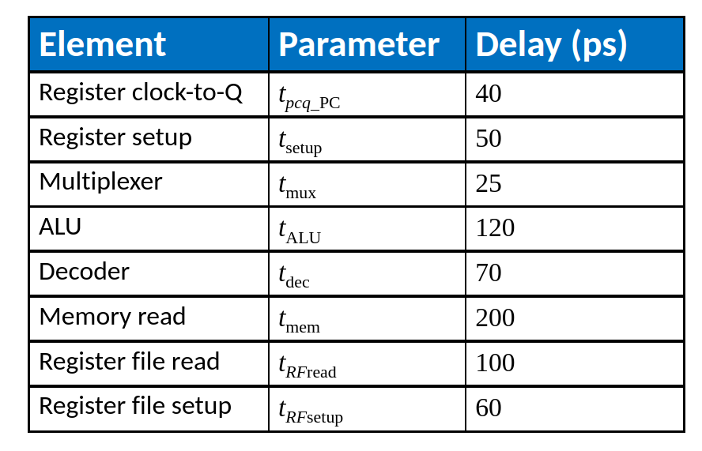
Single-Cycle Performance​
Single-cycle critical path:​
Tc1 = tpcq_PC + tmem + tdec + max[tmux + tRFread, tsetup + tmux] + tALU + tmem + tmux + tRFsetup​
Typically, limiting paths are: ​
memory, ALU, register file ​
Tc1 = tpcq_PC + 2tmem + tdec + tRFread + tALU + 2tmux + tRFsetup​
​

Slide 64
Single-Cycle Performance Example​
Tc1 = ?​
​

Slide 65
Single-Cycle Performance Example​
Tc1 = tpcq_PC + 2tmem + tdec + tRFread + tALU + 2tmux + tRFsetup​
= [50 + 2(200) + 70 + 100 + 120 + 2(25) + 60] ps​
= 840 ps​
​
​

Slide 66
Single-Cycle Performance Example​
Program with 100 billion instructions:​
​
Execution Time = # instructions x CPI x TC​
= (100 × 109)(1)(840 × 10-12 s)​
= 84 seconds ​
​

Slide 67
Upnext
Multicycle ARM Processor​

